Slide 1
Data Science Portfolio
Michael Cullen
April 2025

Slide 2
Introduction
Supervised
Unsupervised
Reinforcement

Slide 3

Diabetes Predictor
100,000 rows
Age
BMI
HbA1c level
glucose

Slide 4
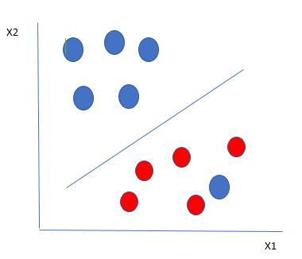
Support Vector Machine

Slide 5
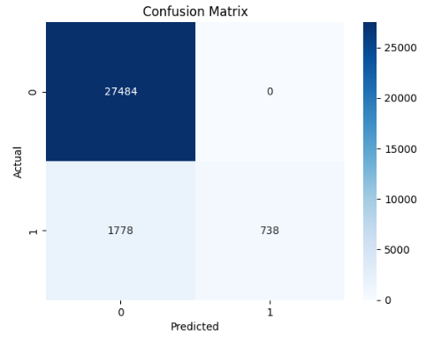
Before

Slide 6
Steps to Fix
SMOTE
Balanced class weight

Slide 7
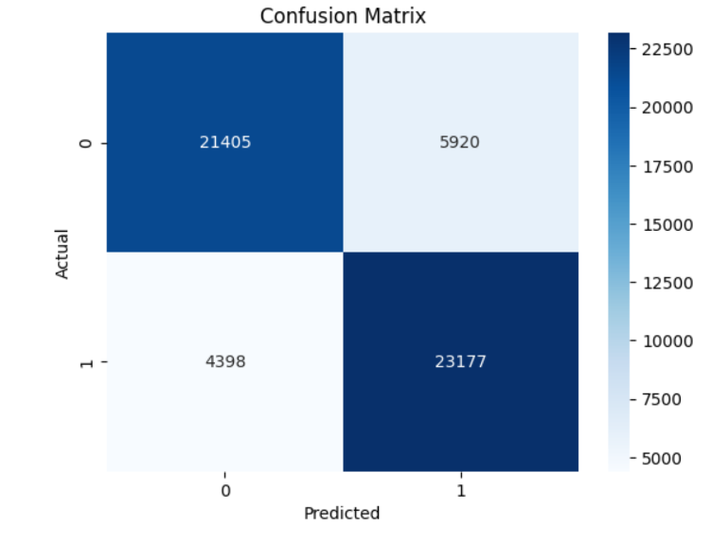
After

Slide 8
Autoencoder (CIFAR-10)
Contains 60,000 small colour images.
Each image has a resolution of 32x32 pixels.
Images are divided into 10 distinct categories.

Slide 9
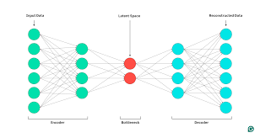
What is it?

Slide 10
Structure of neural network
Encoder: 3 convolution layers to extract features
Latent Vector: 512 values — compressed image
Classifier: Predicts 1 of 10 classes
Decoder: rebuilds image using transposed conv + Tanh
Notes:
Transposed conv builds up the image size. Tanh makes sure the pixel values are in the correct range.

Slide 11
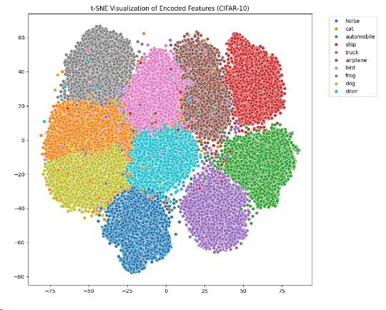

Slide 12
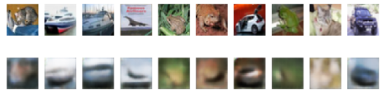

Slide 13
Lunar Landing
Built using prompt-only approach with ChatGPT-4o
Actions = 4 discrete moves
Reward = Based on landing success, crash penalty, fuel use

Slide 14
Deep Q-Network (DQN) Training
trial and error using rewards
replay buffer
Predicts Q-values
Chooses best action most of the time
Updates Q-values to improve over time

Slide 15
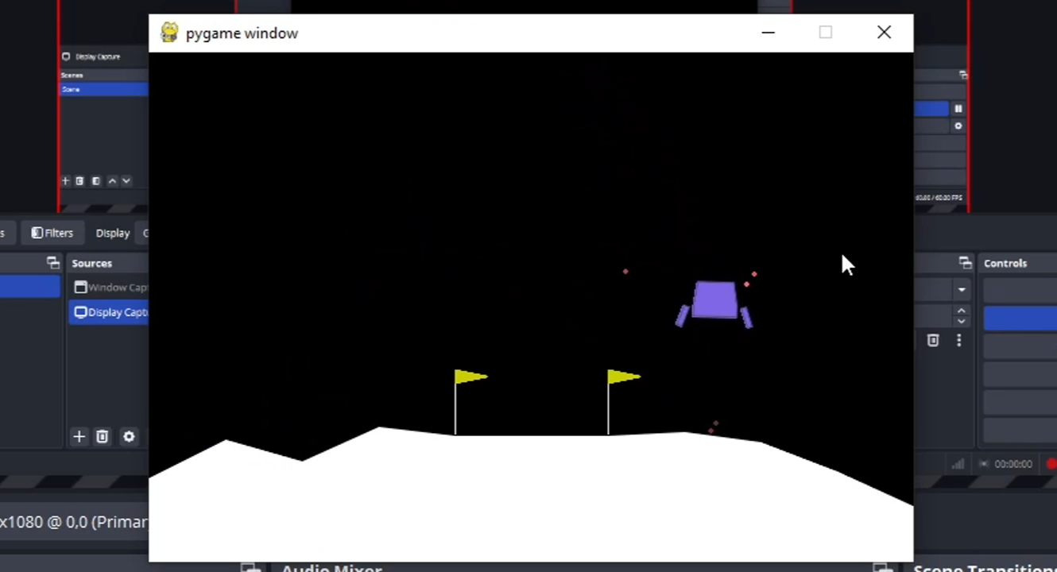

Slide 16
Questions?

